Slide 1
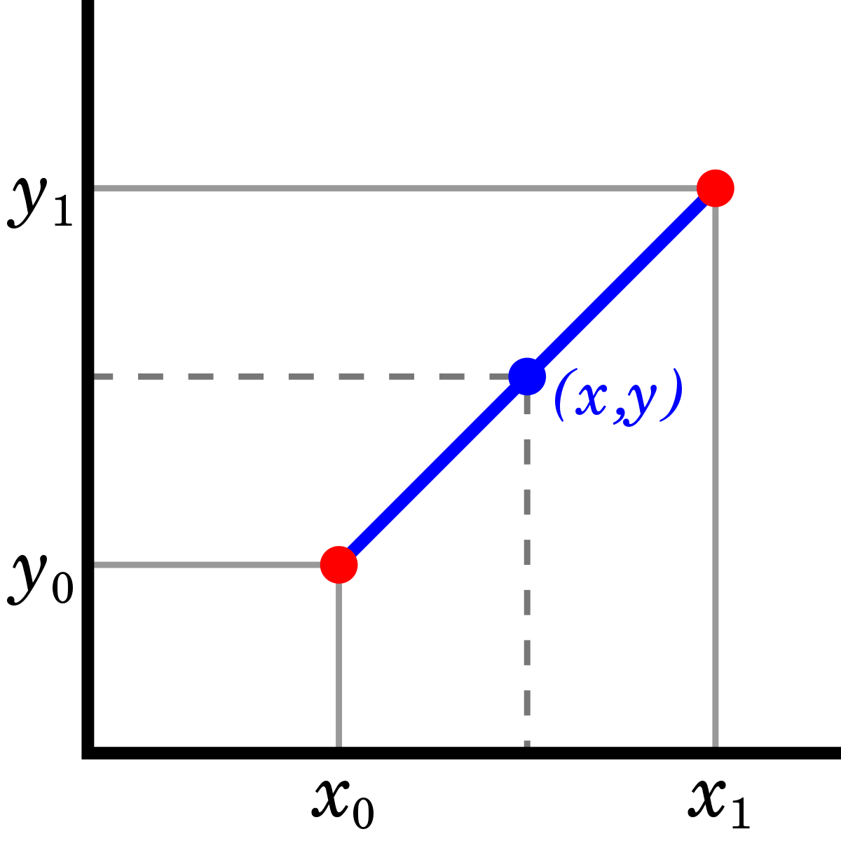
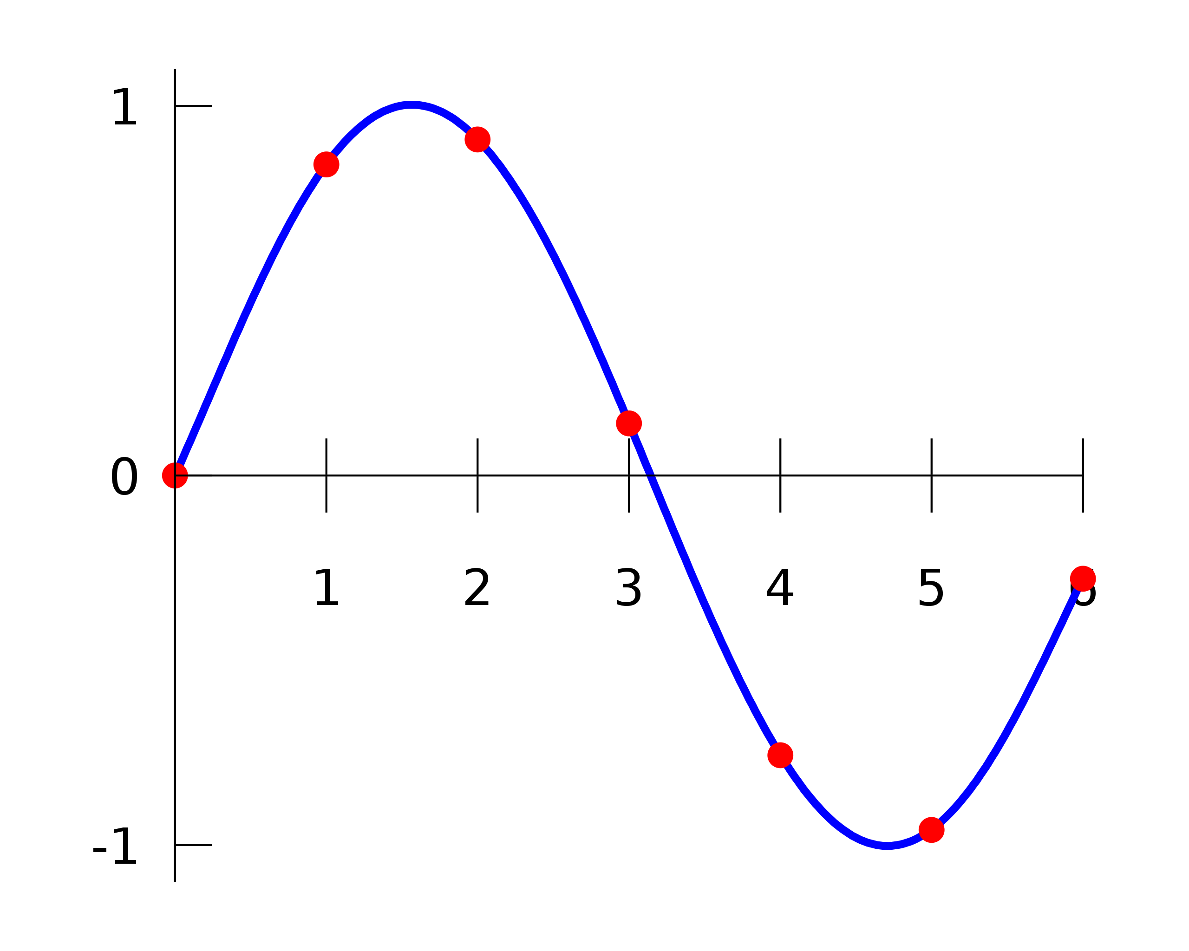
Fractional delay

Slide 2


Fractional delay
x[n]
y[n]
Delay (D)
a
+
What happens when we want non-integer D?
x[n] undefined if n is not an integer
Need to do interpolation
Estimate the value at some location based on values at other locations

Slide 3

Zeroth order interpolation
Just pick the nearest known value
x[m]= x[⌊m+0.5⌋]
Example: x[2.3] = x[⌊2.3+0.5⌋] = x[⌊2.8⌋] = x[2]
x₁
x₀
0
1

Slide 4
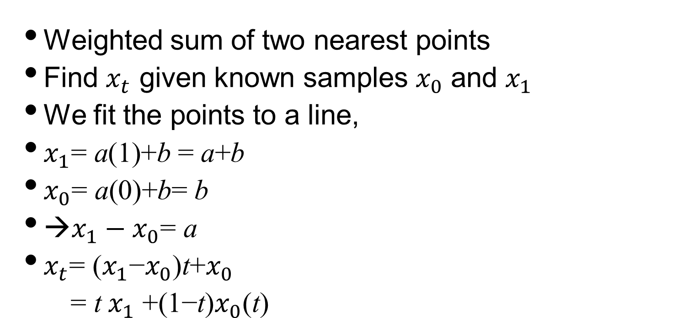
First order interpolation
Weighted sum of two nearest points
Find $x_{t}$ given known samples $x_{0}$ and $x_{1}$
We fit the points to a line,
$x_{1}\text{= }\text{a}\text{(1)+}\text{b} \text{= }\text{a}\text{+}\text{b}$
$x_{0}\text{= }\text{a}\text{(0)+}\text{b}\text{= }\text{b}$
→$x_{1}−x_{0}\text{= }\text{a}$
$x_{t}\text{= (}x_{1}\text{−}x_{0}\text{)}\text{t}\text{+}x_{0}$
$\text{=} {\text{t} x}_{1} \text{+(1−}\text{t}\text{)}x_{0}\text{(}\text{t}\text{)}$
x₁
x₀
0
1

Slide 5
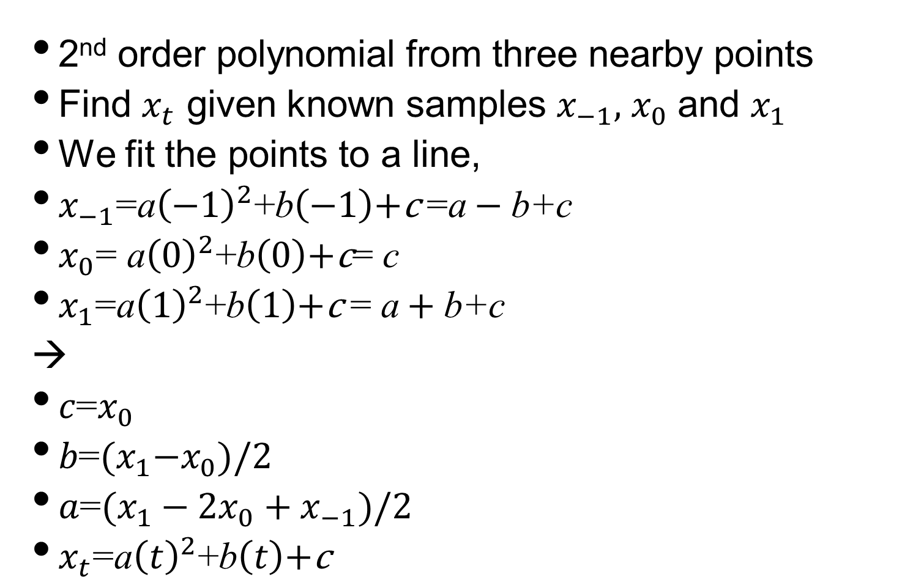
Quadratic interpolation
2nd order polynomial from three nearby points
Find $x_{t}$ given known samples $x_{−1},$ $x_{0}$ and $x_{1}$
We fit the points to a line,
$x_{−1}\text{=}\text{a}{\left(−1\right)}^{2}\text{+}\text{b}\left(−1\right)\text{+}\text{c} \text{=}\text{a}−\text{b}\text{+}\text{c}$
$x_{0}\text{= }\text{a}{\left(0\right)}^{2}\text{+}\text{b}\left(0\right)\text{+}\text{c}\text{= }\text{c}$
$x_{1}\text{=}\text{a}{\left(1\right)}^{2}\text{+}\text{b}\left(1\right)\text{+}\text{c} \text{= }\text{a}+\text{b}\text{+}\text{c}$
→
$c\text{=}x_{0}$
$b\text{=}{(x}_{1}−x_{0})/2$
$a\text{=}(x_{1}−2x_{0}+x_{−1})/2$
$x_{t}\text{=}\text{a}{\left(t\right)}^{2}\text{+}\text{b}\left(t\right)\text{+}\text{c}$
x₁
x₀
-1
0
2
Notes:
Check:
Suppose x_t = 2t^2 –t +1
X0=1
X1=2
X2=7
X_0.5 = 2t^2 + -1 t +1

Slide 6
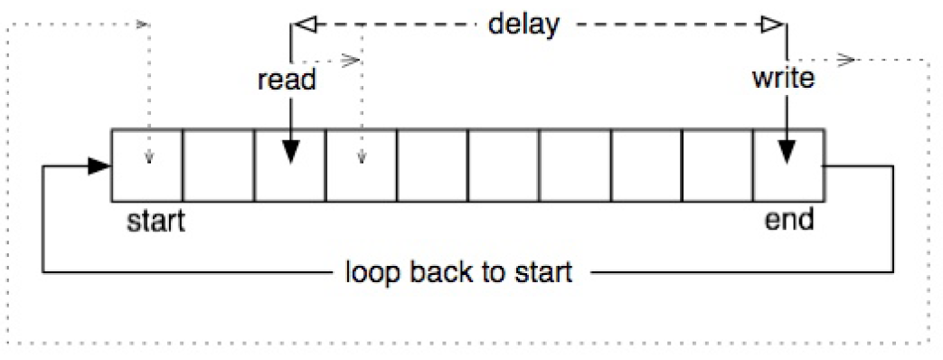
Fractional delay in practice
Use interpolation between samples
Linear (fast), second order or cubic (better quality)
Pseudocode (next slide...)
Input:
An input signal x[n] at sampling rate R
Required delay line size D
Starting delay for read pointer initialdelay
Read pointer update rate updateread (write pointer update rate=1)
Output:
N samples of signal y[n] at sampling rate R (output of read pointer)

Slide 7
Fractional delay in practice
Code does not check whether pointers cross
won’t happen when moving at same speed
pointers moving at different speeds here
Allocate buffer delayline of size D for storing samples
writePosition=0; // write pointer position, start at beginning of buffer
readPosition =(writePosition +D-initdelay)%D;// read pointer position, modulo keeps indexing correct
for (n=0; n<=N-1; n++) {
prev=floor(readPosition); // get previous integer index
next=(prev+1)%D; // get next integer index; because of wraparound, need modulo for safety
t= readPosition – prev; // get fractional position of read pointer
y[n]=(1-t)*delayline[prev]+t*delayline[next]; // Linear interpolation
delayline[writePosition]=x[n]; // write current sample to delay line
readpos=(readPosition+updateread)%D; // update read pointer for next time, modulo wraps
writepos=(writePosition +1)%D; // update write pointer for next time, modulo wraps
}

Slide 8
Interpolate sample
Round to nearest integer. If it rounds to end of buffer, roll back to beginning
float PluginAudioProcessor::interpolateSample(int type,
float delayReadPosition, float* delayData, int delayBufferLength) {
switch (type) {
case 0: { //NearestNeighbour:
int closestSampleIndex = (int)floorf(delayReadPosition + 0.5f);
if (closestSampleIndex == delayBufferLength) closestSampleIndex = 0;
return delayData[closestSampleIndex];
}
…
}
}
Notes:
must pass MidiKeyboardState object to initialise MidiKeyboardComponent object

Slide 9
Interpolate sample
adjust sample weights with fraction by which read pointer between 2 samples
float PluginAudioProcessor::interpolateSample(int type,
float delayReadPosition, float* delayData, int delayBufferLength) {
switch (type) {
…
case 1: { // linear
float fraction = delayReadPosition - floorf(delayReadPosition);
int sample0 = (int)floorf(delayReadPosition);
int sample1 = (sample0 + 1) % delayBufferLength;
return fraction * delayData[sample1]
+ (1.0f - fraction) * delayData[sample0];
}
…
}
}
Notes:
must pass MidiKeyboardState object to initialise MidiKeyboardComponent object

Slide 10
Interpolate sample
adjust sample weights with fraction by which read pointer between 3 samples
float PluginAudioProcessor::interpolateSample(int type,
float delayReadPosition, float* delayData, int delayBufferLength) {
switch (type) {
…
case 2: { //quadratic
int sample1 = (int)floorf(delayReadPosition + 0.5) % delayBufferLength;
int sample2 = (sample1 + 1) % delayBufferLength;
int sample0 = (sample1 - 1) % delayBufferLength;
float fraction = delayReadPosition - sample1;
return (fraction * (fraction - 1) * delayData[sample0]
- 2 * (fraction - 1) * (fraction + 1) * delayData[sample1]
+ fraction * (fraction + 1) * delayData[sample2]) / 2.0f;
}
}
}

